Slide 1







Report on trending technologies and Jobs
By: Debarshi Biswas
Date: January, 2022

Slide 2



OUTLINE
Executive Summary
Introduction
Methodology
Results
Visualization – Charts
Dashboard
Discussion
Findings & Implications
Conclusion
Appendix

Slide 3

EXECUTIVE SUMMARY
In-Demand languages and databases in the current job market
Demographics of
Trending Frameworks
Platforms used
Trending Dev Environments
Gender gaps in the job market

Slide 4

INTRODUCTION
An Analysis of trending technologies such as programming languages, databases, Web Frameworks that are currently used in the Job market
Gives an answer to questions such as:
New in demand Languages and technologies
Gender gap in tech
Education Qualifications of devs
Popular Platforms
Most used dev environments

Slide 5

METHODOLOGY
Collecting Data from
Survey of Stack Overflow Developer 2019
GitHub Job Postings
Data Wrangling
Data Analysis
Data Visualization
Creating Dashboard
Presentation

Slide 6
RESULTS
Data was imported from Stack Overflow Survey and GitHub Job Posting.
The results were visualised in Cognos which lead to finding of:
Highest in demand Jobs
Most used DBMS and growth of Open Source DB systems
Growth in Web Frameworks like React.Js, Angular.Js, Vue.Js.
Popularity of cloud platforms like Docker, AWS, Kubernetes
Gender Gap
Countries lacking in tech
Education Qualifications of devs
Number of senior devs in tech

Slide 7
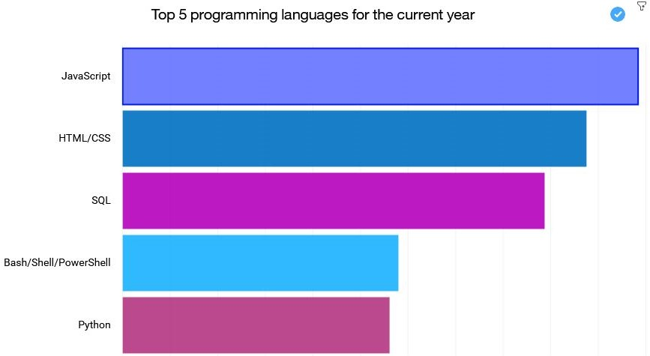
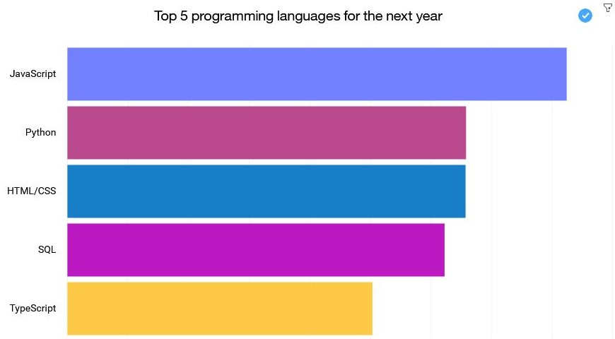
PROGRAMMING LANGUAGE TRENDS
Current Year
Next Year

Slide 8
PROGRAMMING LANGUAGE TRENDS - FINDINGS & IMPLICATIONS
Findings
JavaScript, HTML/CSS and SQL tops the list currently
Python emerges as second most popular language by the next year
TypeScript replaces Bash in the list
Implications
Frontend Development have high demands
Python will probably be the most popular language soon
SQL is quite in demand showing importance of Data management

Slide 9
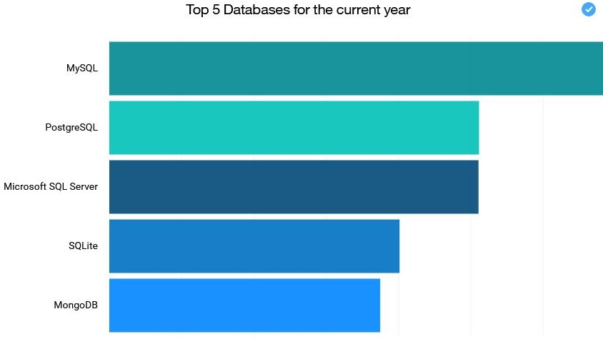
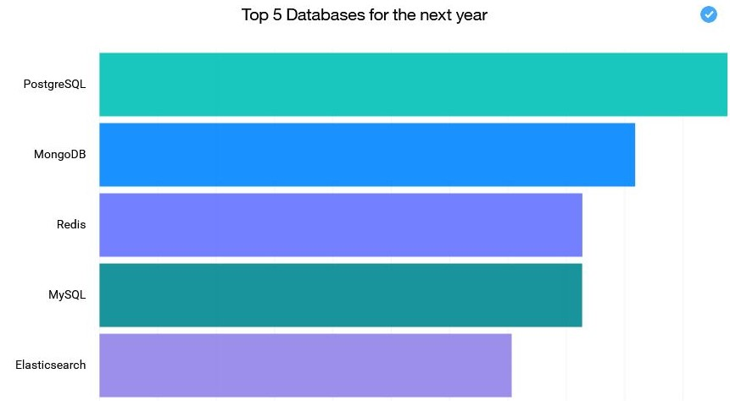
DATABASE TRENDS
Current Year
Next Year
< Bar chart of top 5 databases for the current year goes here >
< Bar chart of top 5 databases for the next year goes here.>

Slide 10
DATABASE TRENDS - FINDINGS & IMPLICATIONS
Findings
PostgreSQL is high in demand followed by MongoDB
SQLite and Microsoft SQL Server is replaced by Redis and Elasticsearch in popularity
Implications
PostgreSQL, MySQL and Redis emerges as popular open-source systems
MongoDB, a NoSQL DBMS stays in demand
ElasticSearch a RESTful Search engine gains popularity

Slide 11

DASHBOARD
The link of the Cognos dashboard:
<https://jp-tok.dataplatform.cloud.ibm.com/dashboards/ec437357-3dd9-4a77-b209-cf205eff9955/view/543aa60a13bd38954ccfb1e407cc2c542c32735ab2bbd50ad6857b495e617397f3691593c82f435bd9145035a0e4105fcb>

Slide 12
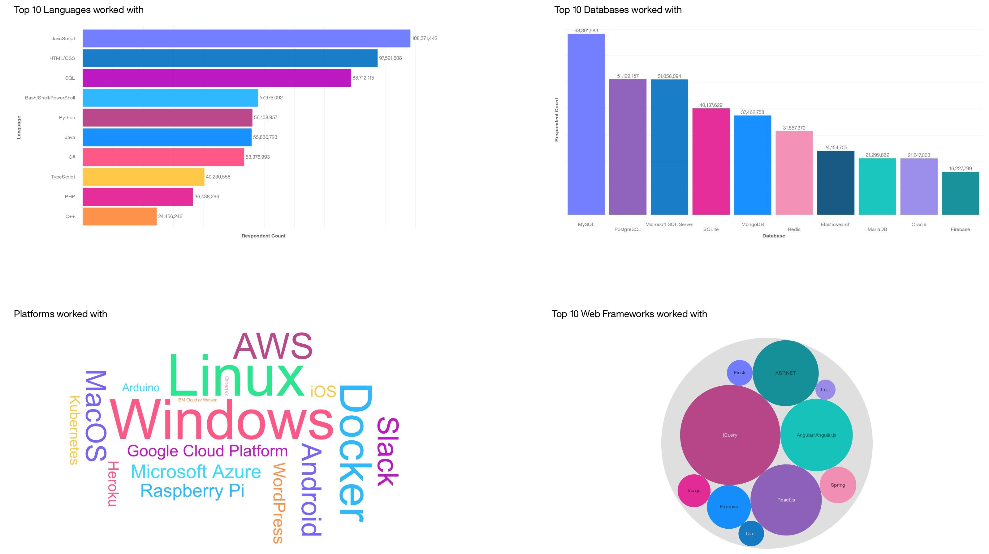
DASHBOARD TAB 1

Slide 13
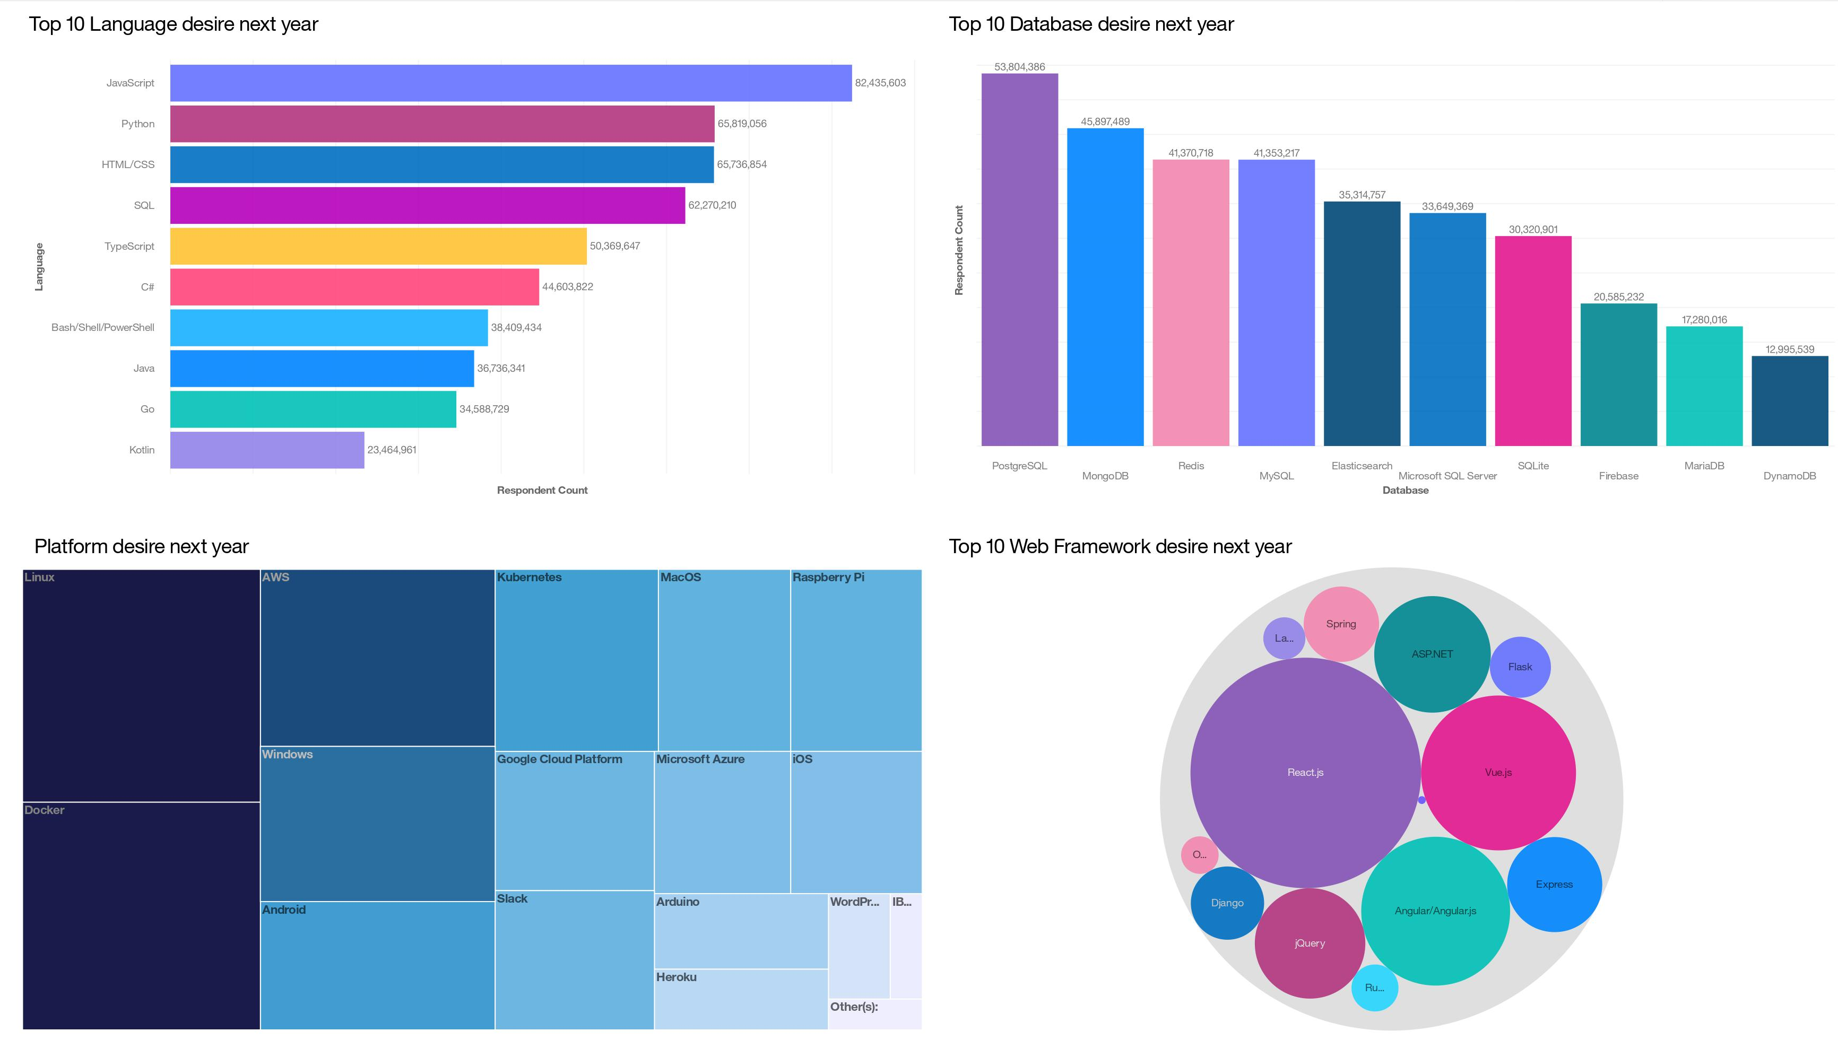
DASHBOARD TAB 2

Slide 14
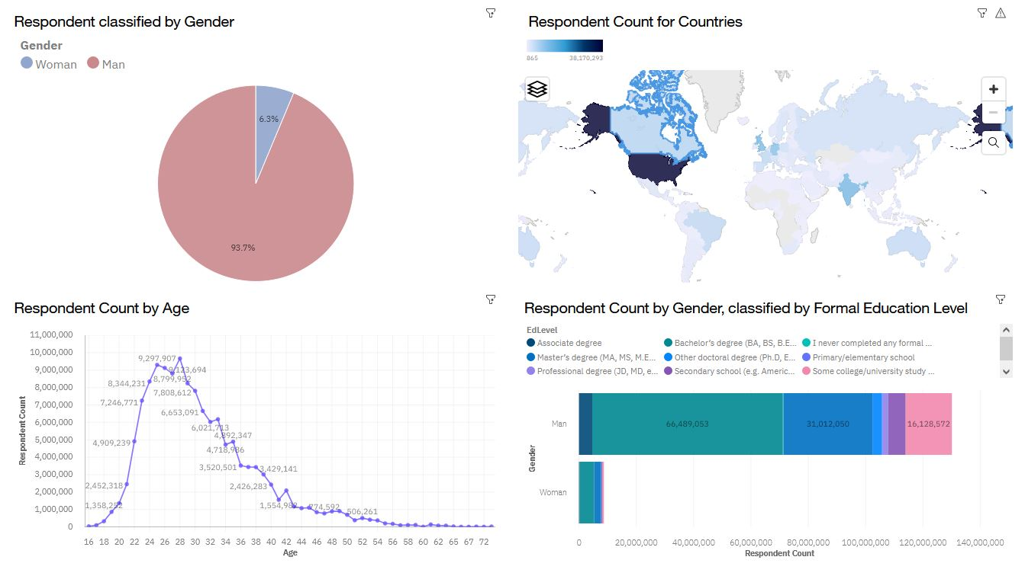
DASHBOARD TAB 3

Slide 15
DISCUSSION
Being at par with the in-demand technologies
Keeping up with new frameworks and systems
Upskilling countries to catch up with rest of the tech world
Gender imbalance in tech

Slide 16
OVERALL FINDINGS & IMPLICATIONS
Findings
Python becomes emerging popular language
Open Source DBMS gains popularity
New Platforms beside with Linux and Windows
Implications
More companies shifting to python based tasks like ML
High demand of DBMS skills
Cloud platforms implys high demand of PaaS services like AWS,Azure

Slide 17

CONCLUSION
Web Development and Python based studies are high in demand
Open Source and NoSQL DBMS gains popularity
Cloud Services like Docker are used heavily
USA have high count of devs followed by India and UK

Slide 18
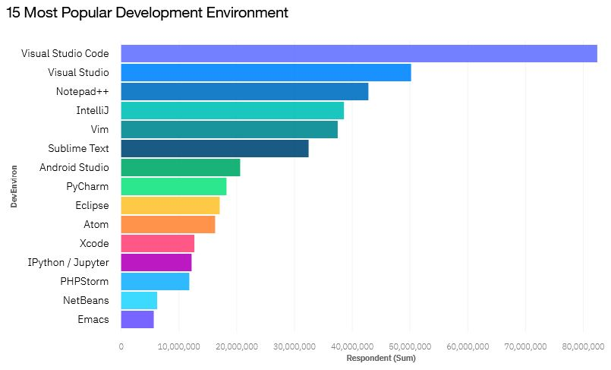

APPENDIX
Include any relevant additional charts, or tables that you may have created during the analysis phase.

Slide 19
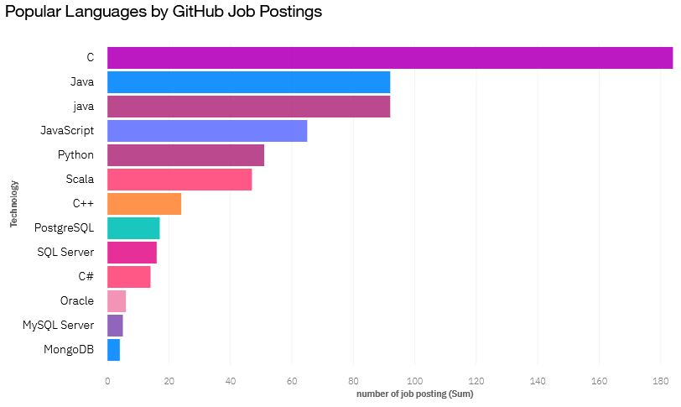
GITHUB JOB POSTINGS

Slide 20
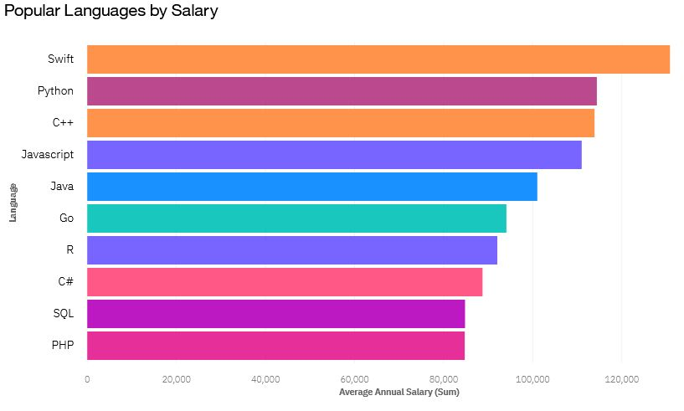
POPULAR LANGUAGES

